Slide 1
DSCI 521 NLP Analysis for Lyrics
Group Members: Yash Gupta – yg444 Shubham Jadhav – sj3237

Slide 2
Project Overview
We analyzed lyrics of songs for several things:
1.Word Count Trends: We aimed to visually represent the overarching patterns in word counts concerning various artists.
2.Lyric Trends: Our focus was on exploring the frequently employed words by distinct artists.
3.Sentiment Analysis: We delved into assessing the overall emotional tone associated with each artist's lyrics.
4.Predictive Modeling: Our goal was to develop a model capable of predicting the artist based on the lyrics of a song.

Slide 3
Work Contribution
Yash Gupta: MS in Computer Science Skills: NLP, Data Pre-processing, Feature Engineering, Networks, Predictive Modeling Contribution: Data Acquisition & Pre-processing, Standardization & Tokenization.
Shubham Jadhav: MS in Computer Science Skills: Data Pre-processing, Visualization, web development, Ml, Numpy, Networks. Worked on: Word Frequency, Visual analysis & Sentiment Analysis, Predictive models, EDA.

Slide 4
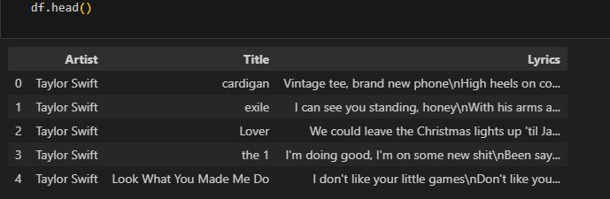
data
We got the data from Kaggle which was divided into 3 columns i.e Artist, Title, Lyrics.
Below are the links:
https://www.kaggle.com/datasets/karnikakapoor/lyrics
https://www.kaggle.com/datasets/deepshah16/song-lyrics-dataset?select=csv

Slide 5
Stakeholders and use of data
Artists: Artists can analyze the length of their songs, their use of words, and the overall sentiment of their music to understand current trends in lyrics, song sentiments, and vocabulary. They can then create songs that align with the current musical landscape.
Music Streaming Platforms: Streaming platforms can utilize our system to gauge the sentiment associated with songs and categorize them accordingly.
Movie Directors: Directors can assess the length of lyrics to ensure they match the general criteria and suggest modifications to lyrics to better suit the overall mood of a scene.
Music Producers: Producers can recommend changes to repetitive words used by artists and suggest alterations in sentiment to meet specific requirements.
Song Writers: Songwriters can employ our predictive model to identify the artists who are best suited to deliver their lyrics effectively.

Slide 6
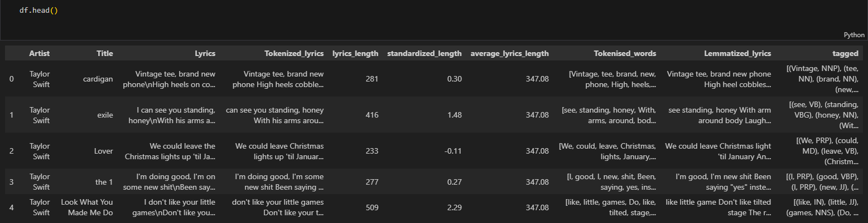
Data Pre-Processing
Tokenized Lyrics: In this section we tokenized all the words in the lyrics and removed all redundant words like “the, is, \n” etc.
Lyrics Length: We calculated the lyrics length for each of the lyrics
Standardized Length: We standardized the Length of each of the lyrics
Average Lyrics Length: We assigned the average lyrics length of all songs combined by each of the actors.
Tokenized Words: In tokenized words we tokenized the words in a list, removed stop words for further POS tagging.
Lemmatized Lyrics: In this section we lemmatized each of the words in the lyrics, removed apostrophes and special characters etc.

Slide 7
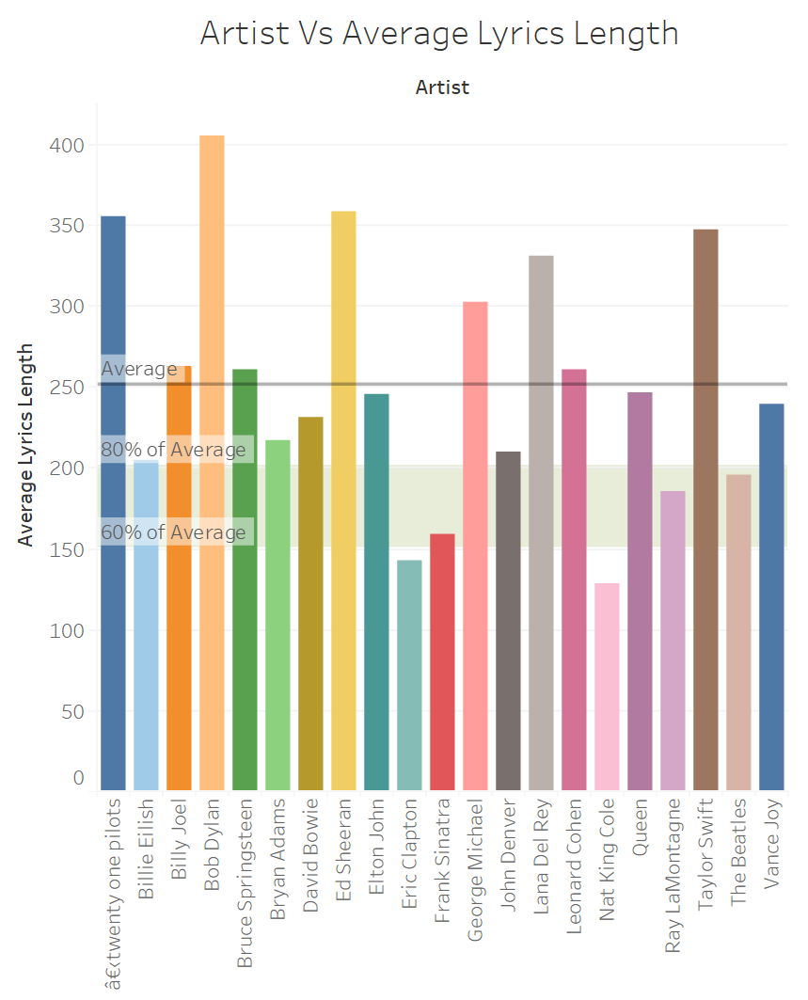
Artists Lyrics Length Plot
In this section we have plotted the average lyrics length for each of the artist.
We have also plotted an Average Trend line to show the average lyrics length and a 80% and 60% average block line.
Through this plot we can clearly see that Bob Dylan is the speechiest artist whereas Nat King Cole is the least speechiest artist among all. While Elton John can be considered as one which is closest to the average lyrics length.

Slide 8
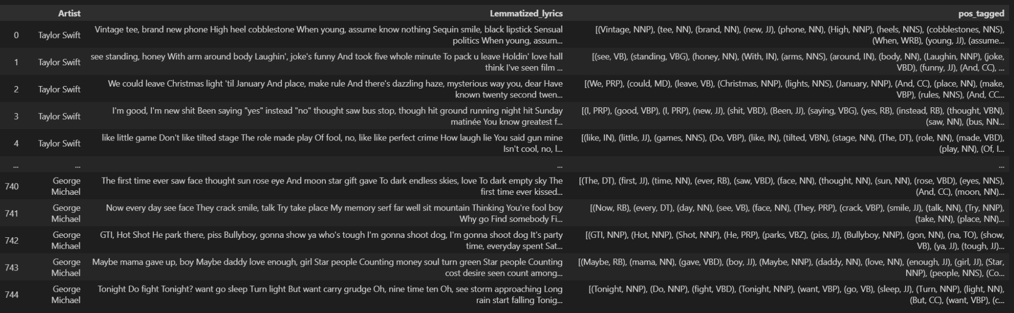
Parts of Speech(POS) Tagging
POS tagging involves the task of assigning the appropriate part of speech labels, such as nouns, verbs, adjectives, and so on, to the words within a sentence.
POS tagging can help to identify the sentiment of a sentence by identifying the adjectives and verbs used in the sentence.
The stopwords and punctuations are excluded and the remaining tokenized words are tagged with their POS.

Slide 9
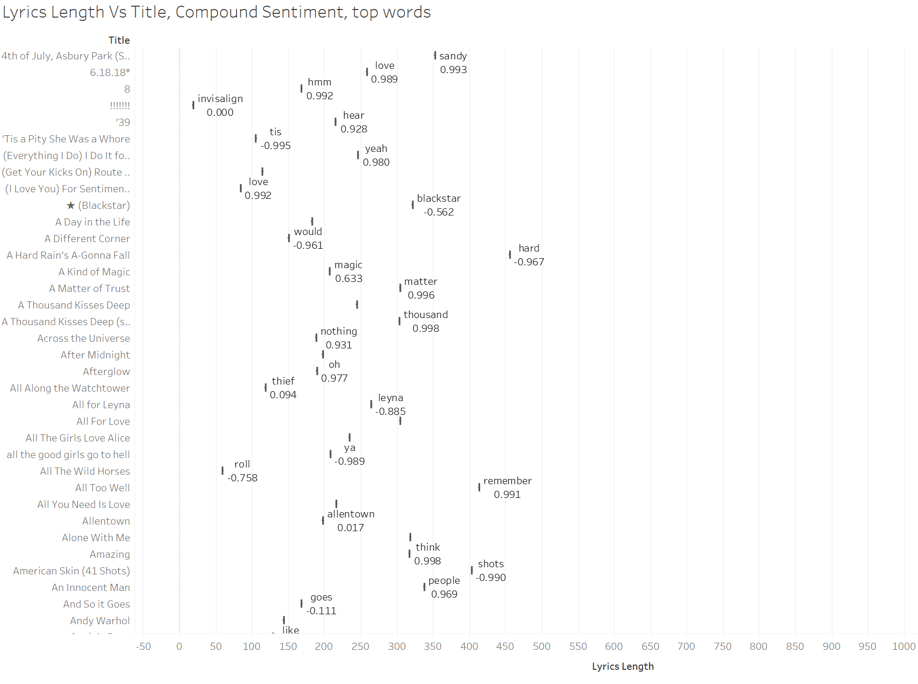

Slide 10
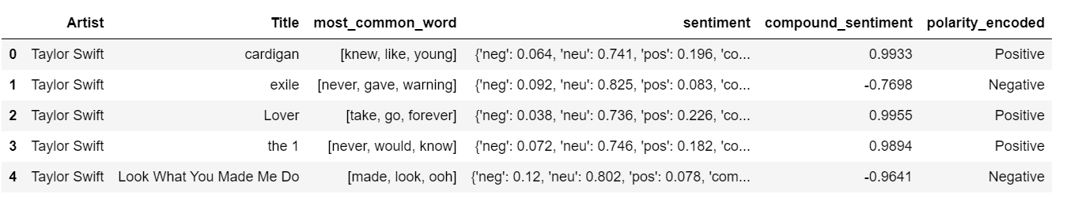
Sentiment Analysis
Sentiment analysis is a natural language processing technique employed to detect, extract, and evaluate subjective content within textual data.
Objective: It is utilized to grasp the emotional undercurrents, attitudes, and viewpoints conveyed within a text.
The sentiment analysis process encompasses the following stages:
Preprocessing (DATA cleaning, tokenization, and normalization)
Feature extraction (including word frequencies, n-grams, and part-of-speech tags)
Polarity: This refers to the sentiment conveyed by a specific text, phrase, or word, and is quantified as a numerical score within the range of [-1, 1].

Slide 11
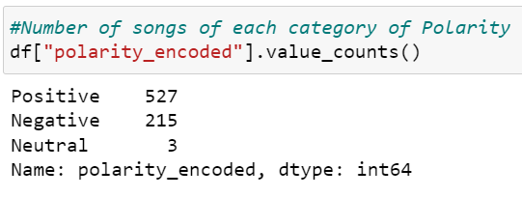
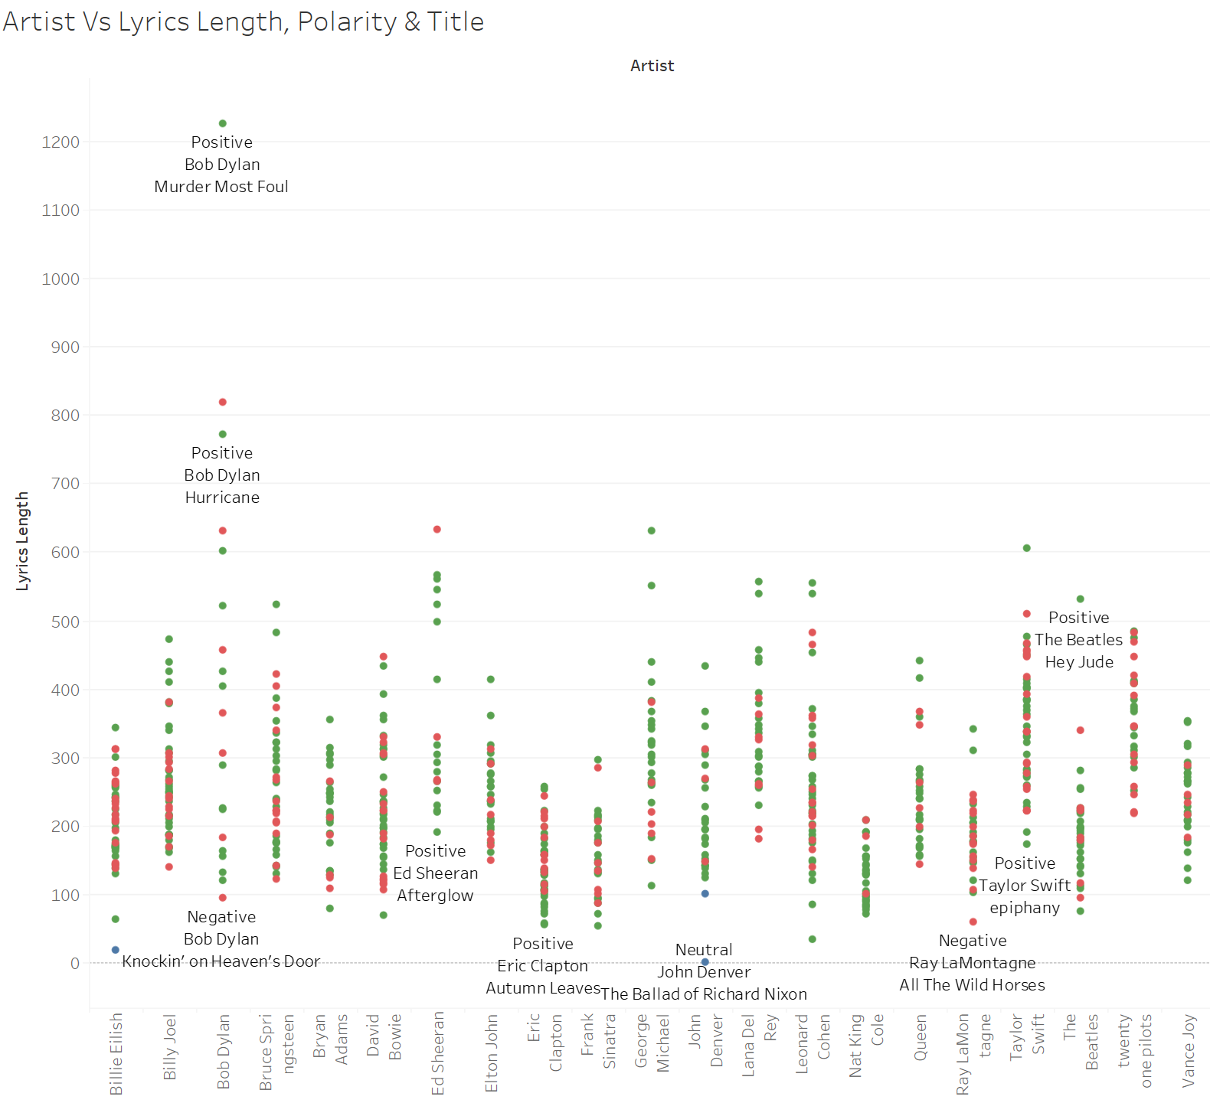
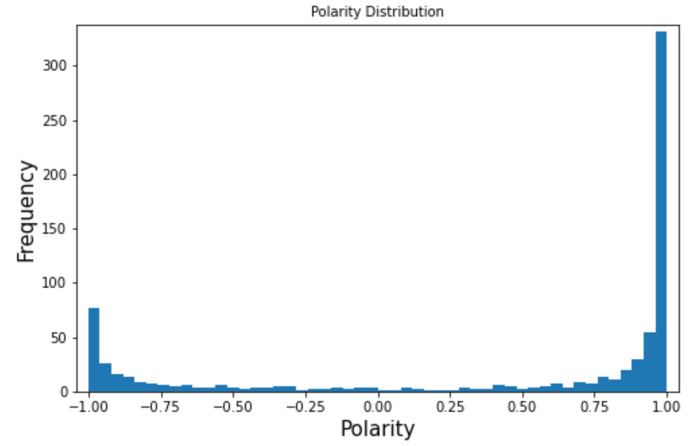

Slide 12
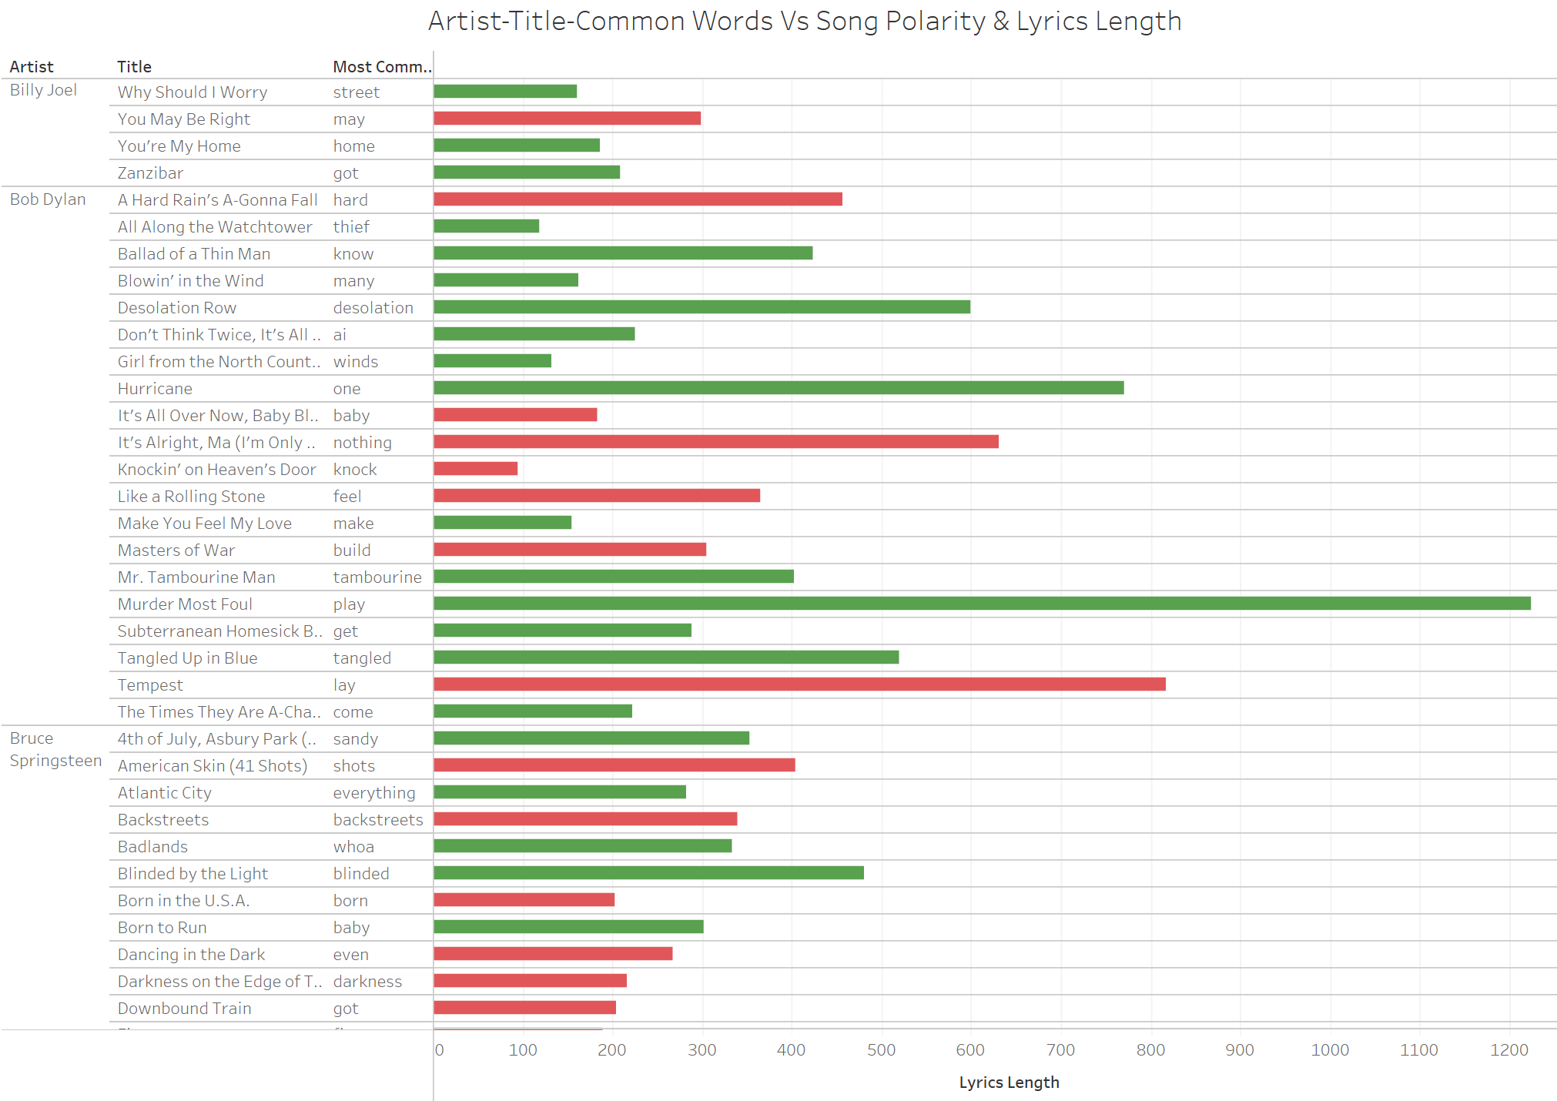

Slide 13
Predictive Models Overview
Data Cleaning
Dense 100 out
ReLu activation
25% Drop
Dense 50 out
ReLu activation
Dataset 1: 745 song total. 21 artists.
Dataset 2: 296 song each of 12 artists.
The Model: Bag Of Words!
25% Drop
Dense 21/12 out Softmax activation

Slide 14
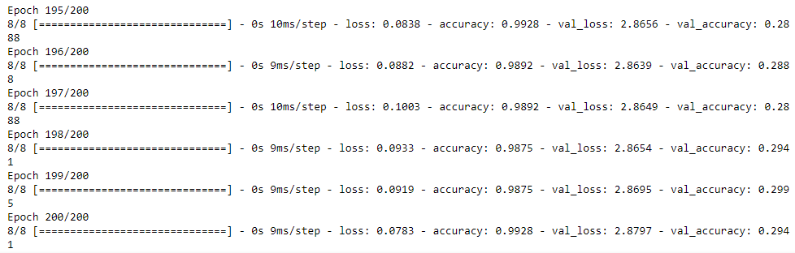
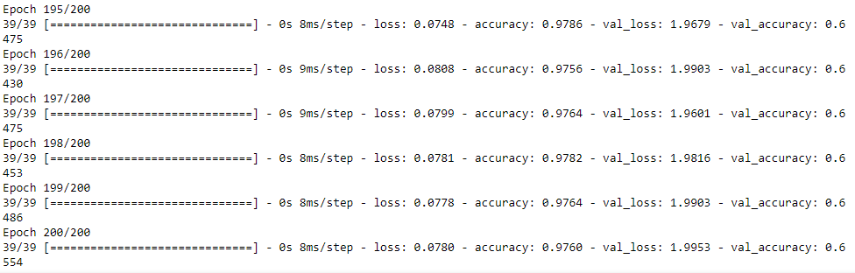
Predictive Models Results
Data Set 1
Data Set 2

Slide 15
Predictive Models Interpretation
Dataset 1 is 6.09x better than random while dataset 2 is 7.92x better than random
There are multiple reasons these results can be seen:
More data provides us with a more accurate prediction.
With dataset 2 having less artists, there may be less genre overlap.
The artists included in the second dataset could use more unique lyrics.

Slide 16
Challenges:
Procuring dataset that is large enough for predictive modeling
Ambiguity of words used in the lyrics for POS Tagging.
Issues:
Some jargons could not be detected during lemmatization
Words used in different languages
Limitations:
Limited Data
Limited Attributes to work on

Slide 17
Future Work
Enrich the dataset with more artists and songs for improved model accuracy and practical versatility.
Extend data with additional categories like billboard rank, release date, album name, and genre, enhancing artist prediction models.
Utilize these new categories to predict billboard rank, aiding songwriters and artists in gauging a song's hit potential.

